Slide 1
WEATHER FORECASTING
Presented by : Chaitrali Naik

Slide 2
Agenda
Introduction
Dataset
Machine Learning
Architecture of Data Analysis
Data Cleaning & Preprocessing
Model Building
Data Visualization
Conclusion

Slide 3
Introduction
Weather forecasting is the prediction of what the atmosphere will be like in a particular place by using technology and scientific knowledge to make weather observations.
It relies on empirical and statistical techniques, such as measurements of temperature, humidity, atmospheric pressure, wind speed and direction, and precipitation, and computer-controlled mathematical models.
In this project, we used Machine Learning to help us to analyse Weather Forecasting dataset.

Slide 4
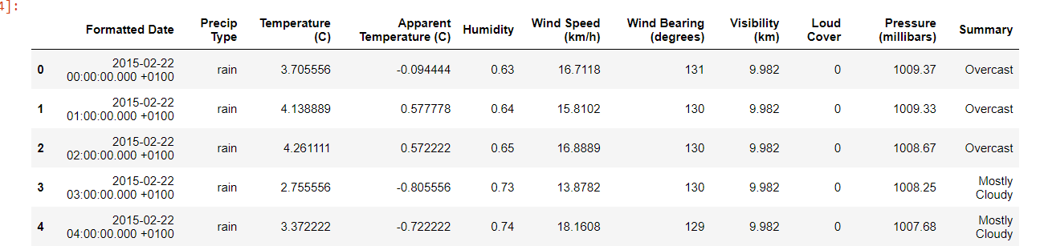
Dataset
We have used Weather dataset having 15000 observations from Kaggle.
Weather data provides information about the weather and it tracks the patterns & predicts trends.
Weather refers to atmospheric conditions and can include indicators such as temperature, humidity, visibility, or wind speed.

Slide 5
Machine Learning
Machine Learning (ML) is a type of artificial intelligence (AL) focused on building computer systems that learn from data.
The broad range of techniques ML encompasses enables software applications to improve their performance over time.
Machine learning algorithms are able to detect patterns in data and learn from them, in order to make their own predictions
Types of Machine Learning :
Supervised Machine Learning
Unsupervised Machine Learning
Semi-Supervised Machine Learning
Reinforcement Machine Learning

Slide 6
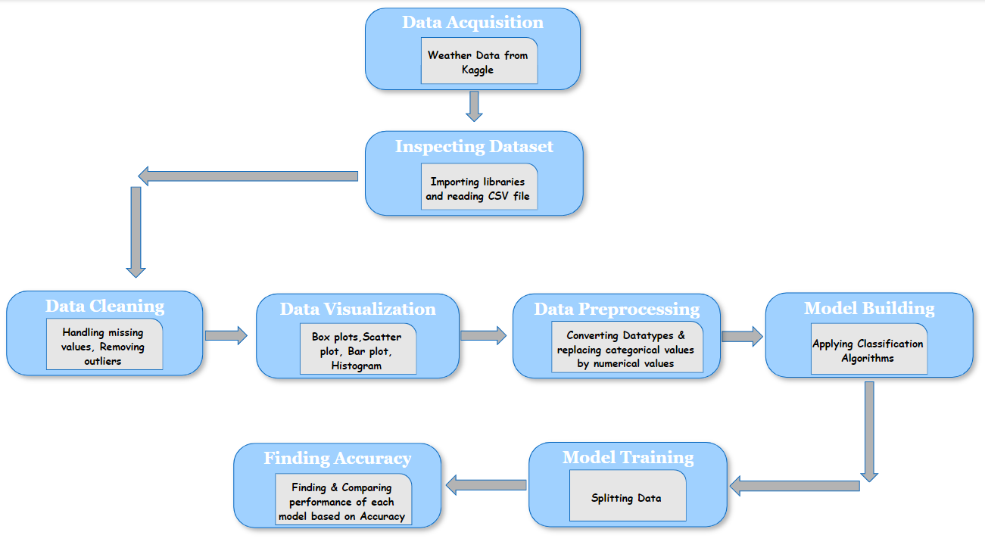
Architecture

Slide 7
Data Cleaning Preprocessing
Data Cleaning : Data cleaning involves identifying and correcting errors in the dataset, such as dealing with missing or inconsistent data, removing duplicates, and handling outliers.
Data Preprocessing : Data preprocessing is a broader concept that includes data cleaning and other steps to prepare the data for machine learning algorithms. These steps may include data transformation, feature selection, normalization, and reduction. The goal of data preprocessing is to convert raw data into a suitable format that machine learning algorithms can learn.

Slide 8
Model Building
We have used here Supervised Learning Algorithm.
Supervised Machine Leaning : This type of ML involves supervision, where machines are trained on labelled datasets and enabled to predict outputs based on the provided training.
It is classified into two categories:
1. Classification
2. Regression
We used Classification algorithms in our project.

Slide 9
Algorithms Used In Project :
Decision Tree Algorithm : It is a tree-structured classifier, where internal nodes represent the features of a dataset, branches represent the decision rules and each leaf node represents the outcome.
Random Forest Classifier : The random-forest classification algorithm is a machine learning technique that employs learning to combine two or more machine learning models to produce a new single model. It works by training the dataset with many decision trees and then presenting the categorization modes of the various trees.
SVM (Support Vector Machine) : It is a type of supervised machine learning algorithm. Here, Machine Learning models learn from the past input data and predict the output. Support vector machines are basically supervised learning models used for classification and regression analysis.

Slide 10
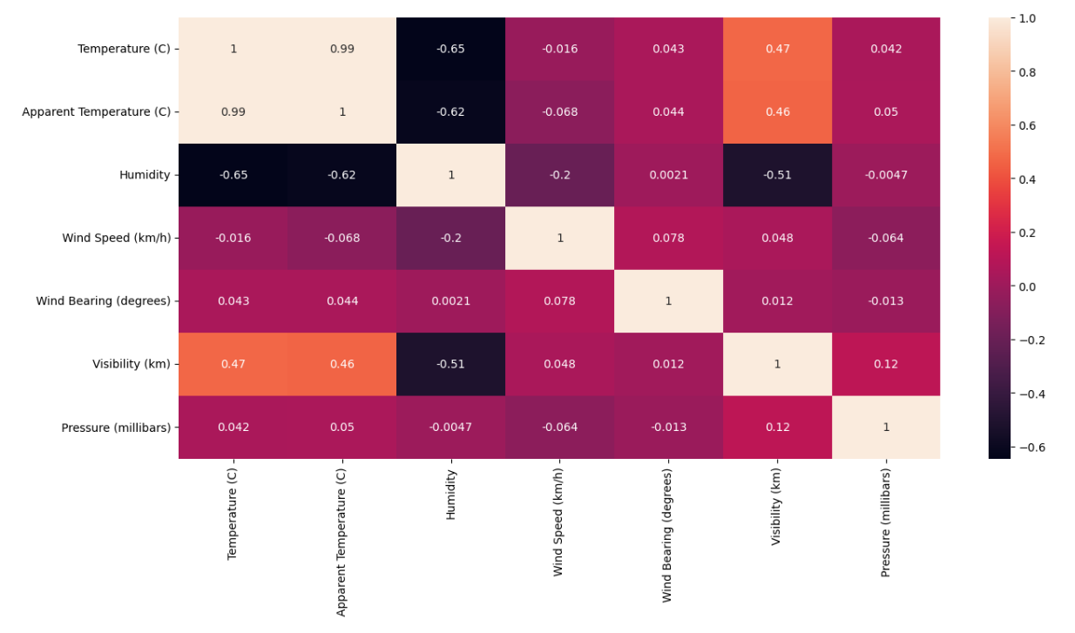
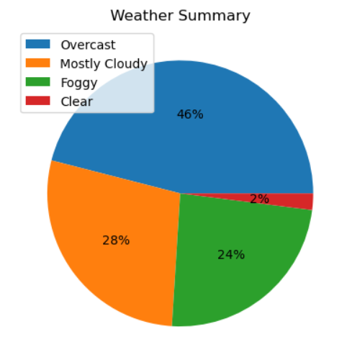
Data Visualization
Heatmap showing relationships between variables
Pie chart showing Weather Summary

Slide 11
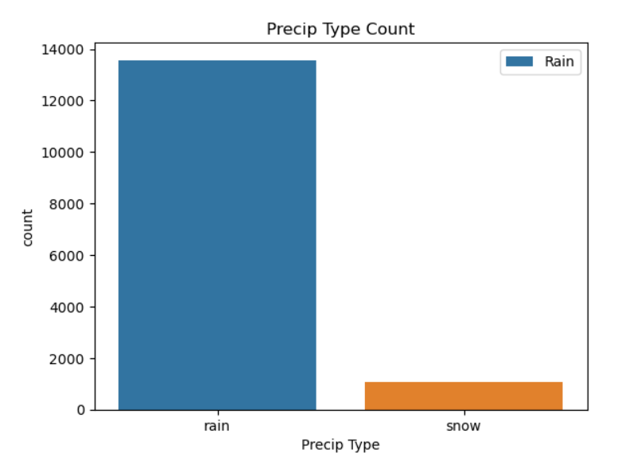
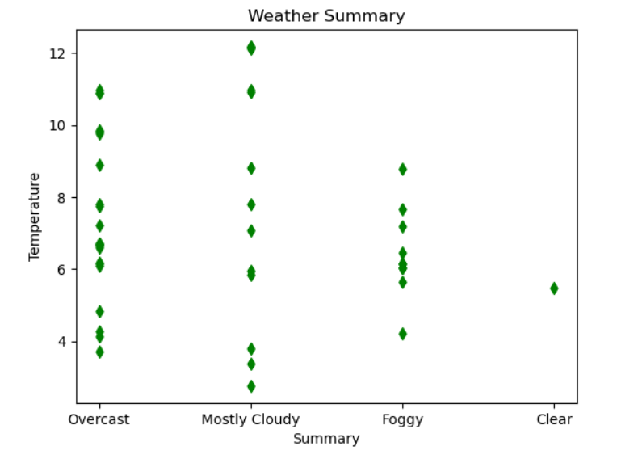
Count of Precip type
Weather Summary by Temperature

Slide 12
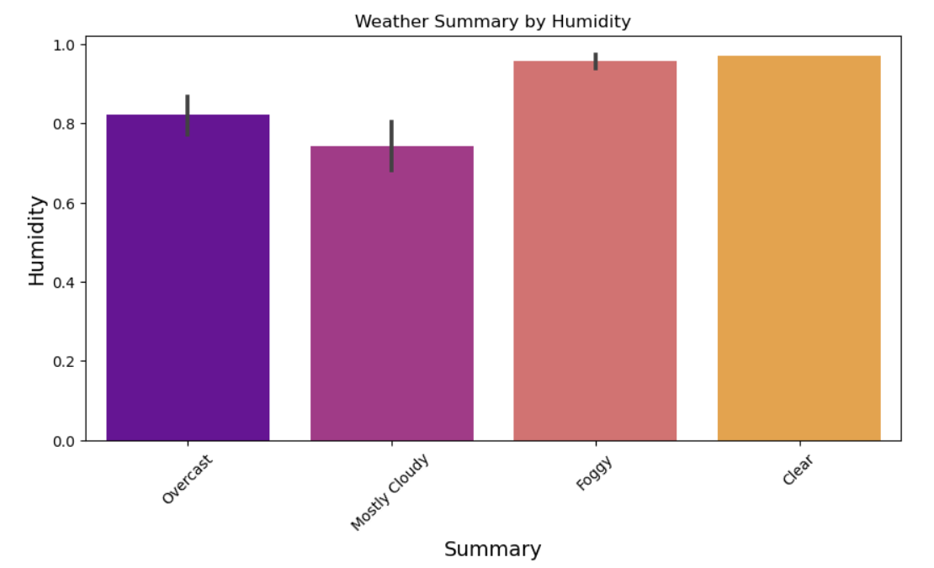
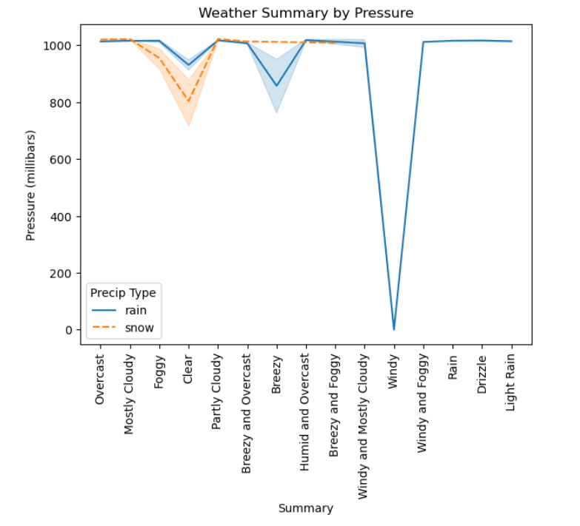
Weather Summary by Humidity
Weather Summary by Pressure

Slide 13
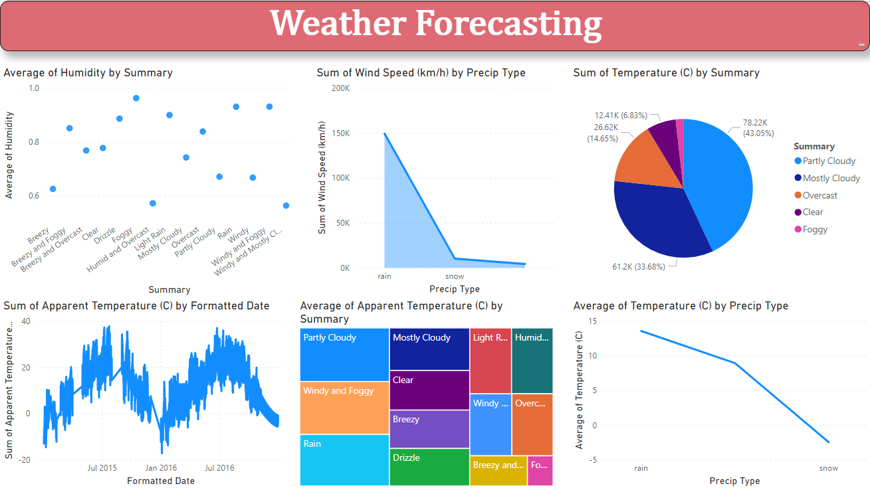
Dashboard Using PowerBI

Slide 14
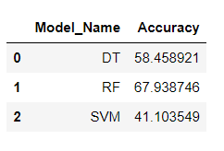
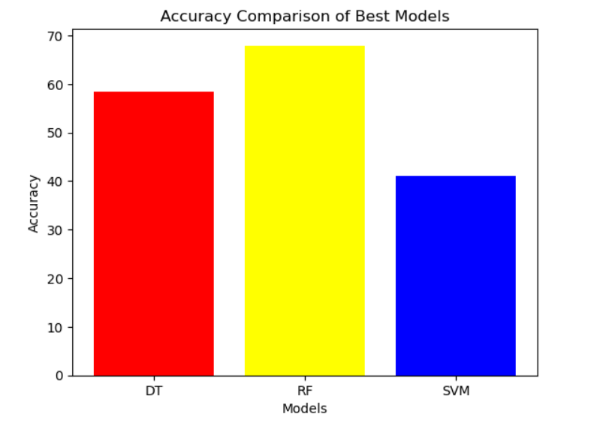
Conclusion
Accuracy of this model achieved for Weather dataset is 66.44%. High accuracy is achieved using Random Forest model then the model with all variables while predicting using test dataset.

Slide 15
Thank You !!!

